Slide 1

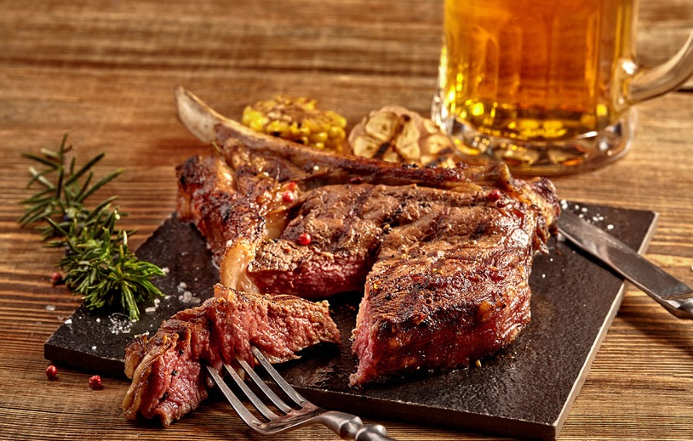

Connecticut | Westchester County | Putnam County | Dutchess County
Omaha Beef Company is a family owned and operated food distribution and processing facility with a mission of satisfying our customers with quality products and service every day.
OMAHA BEEF COMPANY
PRODUCT LIST
9 MAPLE AVENUE | DANBURY, CT 06810
PHONE: 203-748-2651 | FAX: 203-790-5051
www.OmahaBeefCompany.com

Slide 2


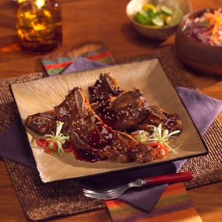
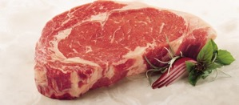
Quality You Can Trust
Connecticut | Westchester County | Putnam County | Dutchess County
Since 1881
Class Name: Choice Beef
Item #
020341
0220481
022045
02210
02234
02247
02268
02320
023527
02911
029110
029111
0291111
029112
029113
029114
029115
029116
02912
02913
02914
02915
02917
02918
02919
02921
Description
Teres Major Muscle
Outside Skirt Fat On
National 2PC Boneless Rounds
Gooseneck Rounds
BI Beef Shanks
Premium 5 Up PSMO Fillet
Sterling Silver 0X1 Shell Strips
Canadian PSMO Fillets 8/Up
Chuck Flap Tails
Premium XT Inside Rounds
Premium 0X1 Boneless Shell
Premium Eye Rounds
Premium Short Ribs (Rib)
Premium Export Ribs
Premium 0X1 Short Loin
Premium Boneless Ribeye
Premium Hanging Tenders
Premium XT Shoulder Clods
Premium Peeled Knuckles
Premium Boneless Top Butts ¼”
Premium Boneless Briskets
Premium Bottom Round Flats
Premium Flank Steaks
Premium Special Trim
Premium Chuck Roll N/O
Premium Inside Skirt Steaks
Pack Size
---
50 LB
70 LB
3-25 LB
4-10 LB
6-5 LB
5-14 LB
10-7 LB
30LB
5-10 LB
8-6 LB
4 PKG
3-20 LB
2-20 LB
5-13 LB
8-8 LB
4-12 LB
6-10 LB
4-13 LB
5-12 LB
4-12 LB
6-8 LB
6-15 LB
3-20 LB
50B
Unit Size
Case
Case
Case
Case
Case
Case
Case
Case
Case
Case
Case
Case
Case
Case
Case
Case
Case
Case
Case
Case
Case
Case
Case
Case
Case
Case
Short Ribs
Class Name: Prime Beef
02133
02241PRP
02241PRI
02243PR
0247PR
025622
Prime Export Ribs
Prime Top Rounds
Prime XT Top Butts
Prime PSMO Fillets
Prime Boneless Ribeye
Prime OX1 Shell
4-17 LB
3
5PC
---
15 LB
6 PC
Case
Case
Case
Case
Case
Case
Ribeye
9 MAPLE AVENUE | DANBURY, CT 06810
PHONE: 203-748-2651 | FAX: 203-790-5051
www.OmahaBeefCompany.com

Slide 3
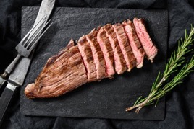
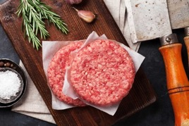

Quality You Can Trust
Connecticut | Westchester County | Putnam County | Dutchess County
Since 1881
Class Name: Grass-Fed
Item #
01040
01042
01043
01044
01045
01046
010466
01048
01049
010491
010492
01053
Description
Grass-Fed Chuck Rolls
Grass-Fed Flank Steak
Grass-Fed Ribeye Boneless
Grass-Fed Bone-In Export Rib
Grass-Fed PSMO
Grass-Fed Inside Round
Grass-Fed Peeled Knuckles
Grass-Fed Striploin Boneless 0 X 1
Grass-Fed Top Butt Peeled Heart
Grass-Fed Femur Bones
Grass-Fed LMC Shoulder Clod Heart
Grass-Fed Trim 50/50
Pack Size
3-15 LB
6/8 PKG
3 PCS
3 PCS
3 PCS
3 PCS
6-10 LB
3 PCS
6 PCS
---
8 PCS
2 / 20 LB
Unit Size
Case
Case
Case
Case
Case
Case
Case
Case
Case
Case
Case
Case
Class Name: Processed Beef
01375
01510
01520
01520CRY
01521CRY
01525
01525CRY
01551
01552
01553
01554
01555
01555CRY
0208005
02080050
02080051
02080055
0208010
021210
02130C22
02245124
0226508V
0226512V
0232010
023202
023203
02351320
02555
Beef Suet Ground
Cube Steaks
Ground Beef 5LB
Ground Beef 5 LB – CRYO
Ground Beef CRYO 1 LB
Ground Beef 10 LB
Ground Beef 10 LB – CRYO
2 ½ oz Pure Beef Patty
3 oz Pure Beef Patty
4 oz Pure Beef Patty
Jumbo Pure Beef Patty
8 oz Pure Beef Patty
8 oz Pure Beef Patty – CRYO 4 /PKG
Short Ribs **Cut 2 X**
Short Ribs PKG Split
Short Ribs **Cut 2”**
Short Ribs **Cut 2 ½”**
Short Ribs – Split
CH Boneless Ribeye Steaks 10 oz
Cowboy B/I Ribeye – Cut 22 oz
Porterhouse Steaks 1 ½”
NY Strip Vein Stk – Cut 8 oz
NY Strip Vein Stk – Cut 12 oz
PSMO Runner On – Cut 10 oz
PSMO – Cut 8 oz
PSMO - Cut 12 oz
Boneless Ribeeye Roll Cut – 3.5 oz Choice
Sliced Beef Liver – Thin
1-10 LB
1-5 LB
1-5 LB
1-5 LB
1 LB
1-10 LB
1-10 LB
1-10 LB
1-10 LB
1-10 LB
1-10 LB
1-10 LB
1-10 LB
1-10 LB
1-10 LB
5-20 LB
10-20 LB
EACH
18 LB
1-20 LB
10 OZ
EACH
---
8 OZ EACH
8 OZ
12 OZ
10 LB AVG
2-10 LB
Case
Pkg
Case
Case
Case
Case
Case
Case
Case
Case
Pkg
Pkg
Pkg
Pkg
Pkg
Pound
Each
Pound
Each
Each
Pcs
Each
Each
Case
Each
Each
Pcs
Case
Our Omaha Beef cutting room has the ability to cut and package steaks to each customers custom specs!

Slide 4
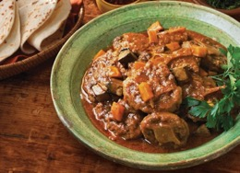
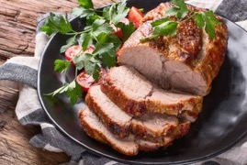
Quality You Can Trust
Connecticut | Westchester County | Putnam County | Dutchess County
Since 1881
Class Name: Beef Product MI
Item #
01355
01370
02135
02342
02525
02545S
02546S
02550
02570
02573
02580
02585
02581
Description
Beef Femur Bones
Beef Suet
Beef Back Ribs – IBP
Beef Hearts
Beef Tripe HC
Oxtails
Oxtails Cut
Peeled Beef Livers – IBP
Philly Cheese Steaks – Original Philly
Holiday Bulk Philly Steaks – Holiday
Beef Feet
Beef Tongues
Beef Kidney
Pack Size
1-30 LB
1-50 LB
1-60 LB
60 LB
1-10 LB
6 PCS – 15 LB
15 LB
2-10 LB
33-5OZ
1-10 LB
1-35 LB
20 LB
---
Unit Size
Case
Case
Case
Case
Case
Case
Case
Case
Case
Case
Case
Case
Case
Oxtail Soup
Class Name: Pork Leidy Fresh
03282
03281
03023
03282PR
03024
030242
030243
03026
03039
03042
03047
03047G
03065
03066
03105
03105B
0311816
03162
03190
03201
03262
032631
032641
03270
03272
Leidy CRYO Fresh Ham
Leidy BI CC Pork Loin
Leidy Pork Loins
Leidy Paper BI CC Loins
Leidy Paper Pork Loins
Leidy Paper BI Butts
Leidy Paper Boneless Butts
Leidy Fresh Hams
Leidy Pork Butts CVP
Leidy Fresh Pork Skins
Leidy Boneless Pork Butts
Leidy Boneless Pork Butts Ground
Leidy Pork Tenderloins
Belly Skins
Leidy 3/DN Spare Rib
Leidy Skin On Pork Loin
Leidy Pork Shank Osso Bucco
Leidy St. Louis Ribs CRYO-VAC
Leidy Skinned Jowls Fresh
Leidy Salted Fat Back Skin On
Leidy Toes On Fresh Ham
Leidy Smoked Daisey Roll
Leidy Easy Carve Ham
Leidy ½ Spiral Hams
Leidy Pork Boneless Sirloin
4-12-14 LB
6-7 LB
4-15/17
4-10 LB
4-14/17
4-8
60 LB
2-14/20
4-8 LB
1-60 LB
1-40
---
1-12 LB
10 LB
1-30
2X25
4-16 OZ
15-20 LB
1-60 LB
50 LB
1/25 LB
---
3 PC
4-8 LB
26 LB
Case
Case
Case
Case
Case
Case
Case
Case
Case
Case
Case
Case
Case
Case
Case
Case
Case
Case
Case
Case
Case
Case
Case
Case
Case
Pork Loins

Slide 5

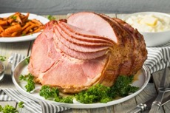
Quality You Can Trust
Connecticut | Westchester County | Putnam County | Dutchess County
Since 1881
Class Name: Pork Leidy Fresh (Cont)
Item #
03275
03276
03277
032821NT
03023NT
03026N
03039NT
03065NT
03159NT
03162NT
03282N
03282NTP
03283
03284
032841
03284T
03285
03325
03347
033477
03349
033491
03710
03711
03725
03726
03815
03815DER
041101
04301
Description
Leidy Whole Spiral Ham
Leidy Fresh Hocks
Leidy Skin-On Shank
Leidy Natural Boneless Pork Loins
Leidy Natural Pork Loins
Leidy Natural Fresh Ham
Leidy Natural B/I Pork Butts
Leidy Natural Pork Tenders
Leidy Natural Loin Back
Leidy Natural St. Louis Ribs
Leidy Natural CC BI Loins
Leidy Natural Boneless Loin Filet
Leidy Fresh Picnic
Leidy Rhine On Bellies
Leidy Rhine Off Fresh Bellies
Leidy Pork Tongue
Leidy Rib Bellies BI
Leidy 17/20 Smoked Ham
Leidy CC Smoked Pork Loins
Leidy Boneless Smoked Pork Loin
Leidy Pork Scrapple
80/20 Pork Trim
Leidy ABF ¼ Cut Smoked Ham
Leidy ABF Whole Ham
Leidy Chub Bacon
Leidy Grill Steaks
Leidy Slab Bacon
Leidy Premium Slab Bacon (Derined)
Leidy Skinned Jowls Frozen
Leidy Retail Lard 14OZ
Pack Size
1-13 LB
30/CS
30 LB
3 PC
2-20 DN
2-17 LB
4-8LB Avg
10 PC
20 LB Avg
1-20 LB
2-17 LB
8
---
50 LB
50 LB
---
55 LB
2-17/20
3-10
4 LB
10 LB
60 LB
4 PC / 5 LB
2/6 LB
1-12.5 LB
1-12 LB
4-10 LB
5-10/12 LB
60
12-14OZ
Unit Size
Case
Case
Case
Case
Case
Case
Pound
Case
Case
Case
Case
Case
Case
Case
Case
Case
Pound
Case
Case
Case
Case
Case
Case
Case
Case
Case
Case
Case
Case
Case
9 MAPLE AVENUE | DANBURY, CT 06810
PHONE: 203-748-2651 | FAX: 203-790-5051
www.OmahaBeefCompany.com

Slide 6
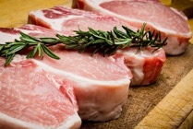

Quality You Can Trust
Connecticut | Westchester County | Putnam County | Dutchess County
Since 1881
Class Name: Pork Frozen Product
Item #
03048
03518
03159U3
03335
03350
03585
03590
04020
04060
04070
04080
04090
Description
Austin Blues Pulled Pork – Hormel
Leidy CRYO Loinback Ribs
IBP Loin Back Rib 3 PC
Leidy Smoked Hocks
Leidy Smoked Neck Bones – Smithfield
Leidy Fresh Neck Bones
Pork Tongue
Pork Ears
Pig Front Feet
Pork Tails
Leidy Bulk Pork Livers
Lundy’s #10 Chitterlings – Smithfield
Pack Size
1-10 LB
1-15 LB
6-3PC
1-30 LB
1-35 LB
1-30 LB
1-20 LB
1-30 LB
1- 30 LB
1-30 LB
60 LB
6-10 LB
Unit Size
Case
Case
Case
Case
Case
Case
Case
Case
Case
Case
Case
Case
Class Name: Pork Product Misc.
Item #
03022
03016
03040B
03130
04300
02910
04350
04370
04380
04385
Description
B/I CC Pork Loins – Seaboard/Smithfield
Premium Reserve CC 8-Bone Loin
Hatfield Boneless Pork Butts
Hatfield Ribeez
Lard 35 LB Tub – Lundy
Beef Middles 60/65
Pre Flushed Hog Casings
Tube Hog Casings
Sheep Casings
Bung Casings
Pack Size
4-18/20 LB
1-3 LB AV
55 LB
11 LB
1-35 LB
1-Hank
1-Bag
1-Tube
1-Hank
1-Each
Unit Size
Case
Case
Case
Case
Case
Case
Each
Each
Each
Each
Class Name: Pork Processed
Item #
03009867
03075
03282CHN
03009825
03009835
03009920
03009940
0301510
0301512
03016
0301612
0301614
03347201
Description
CC Boneless Pork Chops 8oz
Fresh Ham BRT
Leidy Frenched BI CC pork Loin
Pork Loin PCS Cut ½”
Pork Loin PCS Cut ¾”
Pork Loin PCS Cut 1”
CC Bone-In Pork Chop Cut ½”
CC Bone-In Pork Chop Cut ¾”
CC Bone-In Pork Chop Cut 1”
CC Frenched Pork Chops 10oz
CC Frenched Pork Chops 12 oz
Premium Reserve CC 8-Bone Loin
CC 12oz Frenched Pork Premium Reser
Pack Size
8 OZ
18 LB
10-14 LB
1-12-16 LB
14-18 LB
14-18 LB
1-12-16 LB
1-12-16 LB
10-12 LB
10 OZ
12 OZ
1-13 LB
10 OZ
Unit Size
Each
Piece
Piece
Piece
Piece
Piece
Piece
Case
Each
Each
Each
Each

Slide 7
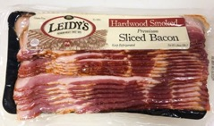
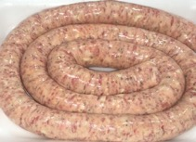
Quality You Can Trust
Connecticut | Westchester County | Putnam County | Dutchess County
Since 1881
Class Name: Bacon Products
Item #
037251
03729
03731
03741
0375005
03810P
03860
037241
03742
03815
Description
Leidy VP Bacon
Leidy Nat Tradition Uncured Bacon
Celebrity Slab Bacon
Leidy Layer Bacon 18/22 Ct
Cooked Bacon
Leidy Bacon Ends and Pcs
Canadian Bacon
Hatfield Applewood Bacon 16/18
Hatfield Signature Layout 18/22
Leidy Slab Bacon
Pack Size
12-1 LB
16-12 OZ
3 Per Case
1-15LB
300 Slices
1-50 LB
6-3 LB
1-15 LB
1-15 LB
4-10LB
Unit Size
Case
Case
Case
Case
Case
Case
Case
Case
Case
Case
Class Name: Sausage Product
Item #
04540
04400
044005
044051
04410
044105
04420
044205
0442051
04430
044305
0443051
04560
04620
04650
04600
04610
04680
Description
Hormel 2oz Cook Sausage Patty
Italian Sweet Sausage – 10 LB
Italian Sweet Sausage – 5 LB
Italian Sweet Sausage – 15 LB
Italian Sweet Sausage – Loose 10 LB
Italian Sweet Sausage – Loose 5 LB
Italian Hot Sausage – 10 LB
Italian Hot Sausage – 5 LB
Italian Hot Sausage – 15 LB
Italian Hot Sausage – Loose 10 LB
Italian Hot Sausage – Loose 5 LB
Italian Hot Sausage – Loose 15 LB
Leidy Sausage Rolls Mild
DeYulio Breakfast Sausage
DeYulio H/C Sausage 1-10 LB
DeYulio Italian SW Sausage Links
DeYulio ITL Hot Sausage Link 5 LBS
DeYulio Loose Hot Sausage 5 LBS
Pack Size
80-2 OZ
10 LB
5 LB
15 LB
1-10 LB
5 LB
10 LB
5 LB
15 LB
10 LB
5 LB
15 LB
12 LB
1-10 LB
1-10 LB
1-5 LB
1-5LB
1-5LB
Unit Size
Case
Case
Case
Case
Case
Case
Case
Case
Case
Case
Case
Case
Case
Case
Case
Case
Case
Case
9 MAPLE AVENUE | DANBURY, CT 06810
PHONE: 203-748-2651 | FAX: 203-790-5051
www.OmahaBeefCompany.com

Slide 8
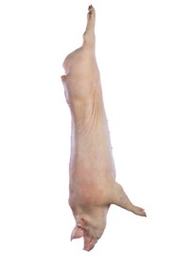
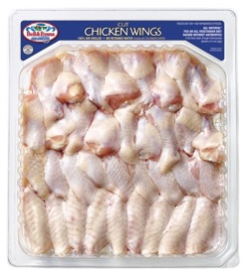
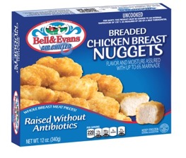
Quality You Can Trust
Connecticut | Westchester County | Putnam County | Dutchess County
Since 1881
Class Name: Whole Pigs
Item #
03000
03001
03002
03003
03004
03005
03006
03007
03008
03009
Description
10-20 LB Suckling Pig
20-30 LB Sucking Pig
30-40 LB Suckling Pig
40-50 LB Suckling Pig
50-60 LB Whole Pig
60-70 LB Whole Pig
70-80 LB Whole Pig
80-90 LB Whole Pig
90-100 LB Whole Pig
100-150 LB Whole Pig
Pack Size
1-10/20 LB
1-20/30 LB
1-30/40 LB
1-40/50 LB
1-50/60 LB
1-60/70 LB
1-70/80 LB
1-80/90 LB
1-90/100LB
1-100/150LB
Unit Size
Each
Each
Each
Each
Each
Each
Each
Each
Each
Each
Class Name: Bell & Evans
Item #
06039
06048
06055
0605602
06057
06062
06109
06111
06112
0611411
06115
06119
06125
06126
06128
06131
06149S
06151
06209
06230
06232
06235
06237
06153
06166
061615
06162
06161
06164
06167
Description
3 LB Chickens
3 ½ LB Chickens
3 LB Shell (WOG)
CVP 2.75 LB WOG (Trussed)
Clipped Fresh Chicken Tenders
Cornish Hens
Breast
Breasts with Wing Joint
Breast Split
Airline Breast 10/12 OZ
B/I Drumsticks
Chicken Legs
Chicken Thighs
Chicken Wings
Boneless & Skinless Chicken Thighs
Buffalo Wings Cut
Boneless Breast Split
Skin-On Boneless Chicken Breast
Chicken Livers
Chicken Necks
Chicken Necks – Cut
Chicken Backs
Chicken Backs – Cut
Bulk Chicken Nuggets
Bulk Chicken Tenders
Retail Nuggets
Retail Breaded Tenders
Retail Chicken Burgers
Retail Italian Patties
Retail Chicken Patties
Pack Size
12-3 LB
10 – 3 ½ LB
12-3 LB
13 HD
20 LB
12-20 OZ
1-40 LB
1-40 LB
1-40 LB
20 LB
1-40 LB
1-40 LB
1-40 LB
1-40 LB
4-5 LB
1-40 LB
4-10 LB
1-40 LB
4-5 LB
1-40 LB
1-40 LB
1-40 LB
1-40 LB
10 LB Box
10 LB Box
12/12 OZ
12/12 OZ
12/12 OZ
12/16 OZ
12/16 OZ
Unit Size
Case
Case
Case
Case
Case
Case
Case
Case
Case
Case
Case
Case
Case
Case
Case
Case
Case
Case
Case
Case
Case
Case
Case
Case
Case
Case
Case
Case
Case
Case

Slide 9
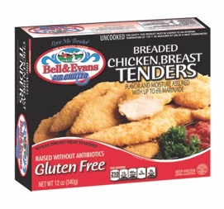
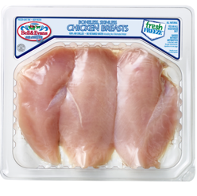
Quality You Can Trust
Connecticut | Westchester County | Putnam County | Dutchess County
Since 1881
Class Name: Bell & Evans (Cont.)
Item #
06168
06170
06172
061722
061723
0617231
0617233
061736
061737
061738
06169
061691
061692
0617280G
04135
04145
04150
Description
Retail Coconut Tenders
Retail Breaded Chicken Cutlets
Retail Grilled Chicken Breast
Retail Gluten Free Nuggets
Retail Gluten Free Breaded Tenders
Retail Gluten Free Breaded Patties
Retail Gluten Free Breaded Breasts
Retail Organic Breaded Tenders
Retail Organic Breaded Nuggets
Retail Organic Breaded Breasts
Retail Gourmet Bacon Cheddar Burger
Retail Gourmet Apple/Guda Burger
Retail Gourmet Mush/Swiss Burger
Chicken Franks Organic
Sweet Italian Chicken Sausage VP
Garlic/Provolone Chicken Sausage
Hot Chicken Sausage VP
Pack Size
12-12 OZ
12/10.5 OZ
12/8.25 OZ
12/12 OZ
12/12 OZ
12/16 OZ
12/10.5 OZ
12/12 OZ
12/12 OZ
12/10.5 OZ
12/12 OZ
12/12 OZ
12/12 OZ
12/16 OZ
10-12 OZ
10-12 OZ
10-12OZ
Unit Size
Case
Case
Case
Case
Case
Case
Case
Case
Case
Case
Case
Case
Case
Case
Case
Case
Case
Class Name: Bell & Evans Tray Pack
Item #
06201
06360
06363
06365
06368
06369
06371
06375
06377
06378
06379
06380
06381
06383
06385
06387
06389
06390
06393
Description
Chicken Livers
3 ½ LB Chickens
Clipped Tenders
Chicken Legs
Boneless & Skinless Breasts
Split Bone-In Breast
Buffalo Wings Cut
Bone-In Thigh
Drumsticks
Thin Sliced Cutlet
Boneless Skinless Chicken Thighs
Organic Legs
Organic 3 ½ Chickens
Organic Drums
Organic Boneless Thighs
Organic Boneless Breast Meat
Organic Bone-In Split Breast
Organic Bone-In Thighs
Organic Cut Wings
Pack Size
12-18OZ
6 HD / Case
10 Tray / Case
10 Tray / Case
10 Tray / Case
10 Tray / Case
10 Tray / Case
10 Tray / Case
10 Tray / Case
10 Tray / Case
10 Tray / Case
10 Tray / Case
6 HD / Case
10 Tray / Case
10 Tray / Case
10 Tray / Case
10 Tray / Case
10 Tray / Case
10 Tray / Case
Unit Size
Case
Case
Case
Case
Case
Case
Case
Case
Case
Case
Case
Case
Case
Case
Case
Case
Case
Case
Case

Slide 10

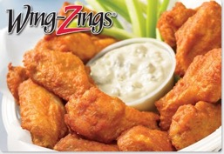
Quality You Can Trust
Connecticut | Westchester County | Putnam County | Dutchess County
Since 1881
Class Name: Poultry Misc.
Item #
06030ALL
062492
06130
06145
06152
0690012
07031
07032
08331
08440
084404
08441
08490
08495
08510
08540
08550
08560
08995
08645
08770
08620
08630
08635
08640
08650
08010
08200
08310
08320
08905
8793
Description
Grade A-3 LB Wog Chickens
Grade A 4 LB Fryers
Grade A Boneless Chicken Things
Grade A Boneless Chicken Breast
Jumbo Party Wings
Chicken Feet
Grade A 3 LB Chicken Split
Grade A 3 LB Chicken Cut 8 Piece
Mt. Aire Black Label Boneless Breast
8 OZ Fresh Boneless & Skinless Breast Bulk
4 OZ Fresh Boneless & Skinless Breast Bulk
6 OZ Fresh Boneless & Skinless Bulk Breast
Pulled Chicken Meat
Diced Chicken Meat
4 Piece Bread Chicken Pierce
Pierce Wing Dings 144 Count
Pierce Wing Zings
Pierce Boneless Wing Dings
Pierce Chicken Nuggets
Chicken Breast Tender Fritters
Chicken Cheese Steaks
Dutch Chicken Tenders
Dutch Supreme Cutlets
Dutch Grilled Chicken Breast
Dutch Hot Wings
Dutch Breaded Chicken Patty
Peltz Whole Rabit
Frozen 8/9 Capons
Frozen 10/14 Geese
Frozen 12/14 Geese
Semi Boneless Quail
Quail Eggs
Pack Size
20-3 LB
18 PC
1-40 LB
1-40 LB
1-40 LB
22 LB
22-3 LB
24-3 LB
4-10 LB
1-20 LB
1-20 LB
1-20 LB
10 LB
10 LB
1-15 LB
2-5 LB
288 CT
1-10 LB
33-5 OZ
53-3 OZ
1-10 LB
1-10 LB
40-4OZ
1-10 LB
1-10 LB
38 / 4,2 OZ
12-3 LB
6-8/9 LB
4-10/12 LB
4-12/14 LB
6-4 PERPKG
18/PKG
Unit Size
Case
Case
Case
Case
Case
Case
Case
Case
Case
Case
Case
Case
Case
Case
Case
Case
Case
Case
Case
Case
Case
Case
Case
Case
Case
Case
Case
Case
Case
Case
Case
PC
9 MAPLE AVENUE | DANBURY, CT 06810
PHONE: 203-748-2651 | FAX: 203-790-5051
www.OmahaBeefCompany.com

Slide 11

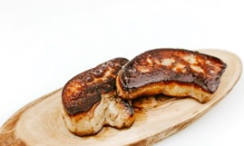

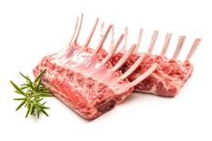
Quality You Can Trust
Connecticut | Westchester County | Putnam County | Dutchess County
Since 1881
Class Name: Ducks – Bella Bella
Item #
00002
0813001
0813004
0813005
0813008
0813085
081386
08160
08161
08163
08166R
08170
08174
087951
09448
8166
Description
Duck Livers
Foie Gras Block 7 OZ w/ Sauternes
Duck Fat, Rendered
Foie Gras, Sliced
Foie Gras Butter
Bella Duck Legs
Frozen Duck Bones
Boneless Duck Breast 16 OZ
Sliced Foie Gras (RTLON 8x6 Board)
Smoked Chicken Breast
Duck Leg Confit 6/pk Each
Moulard Breast Double Lobe
Duck Legs (Bulk)
Duck Breast Single Lobe .9 LB
B&E Ducks Frozen – 5 LB
Maple Leaf Boneless Duck Breast 8/10
Pack Size
---
6-7 OZ
1 GAL
10-2OZ SL
1 LB
24/ Case
50 LB
10-16 OZ
2x2 OZ
2 PK /12 PR
6 PK
12 / Case
20 LB 30 PCS
.9 LB Avg
6-5 LB
24-8/10 OZ
Unit Size
Case
Each
Case
Case
Case
Each
Case
Package
Case
Case
Case
Case
Case
Each
Case
Case
Foie Gras, Sliced & Seared
Class Name: Eggs
Item #
088201
08820
08825
08830
08840L
Description
Medium White Eggs – Loose
Large White Eggs – Loose
15 Dozen Large Loose Eggs
Large White Eggs Carton
Extra Large Loose Eggs
Pack Size
30-DOZ
30-DOZ
1-15 DOZ
30-1 DOZ
1-30 DOZ
Unit Size
Case
Case
Case
Case
Case
Class Name: Lamb Fresh
Item #
05015
05040
0504005
05040PF
05049C
05059C
05101
05121
Description
Baby Lamb 25/35 LB
Legs Lamb Pair
Legs Lamb Pair – Split
CRYO Boneless Legs Lamb
Lamb CYRO Legs Trotter Off
Block Ready Loin Lamb
CRYO Racks Lamb
CRYO Trim Loin Lamb
Pack Size
25/ 35 LB
1-20 LB
18-24 LB
5-6 PC
5-12 LB
6 PC
6-8 LB
6-11 LB
Unit Size
Case
Case
Case
Case
Case
Case
Case
Case
Rack of Lamb

Slide 12
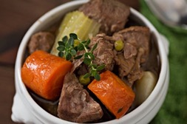
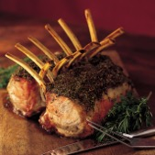
Quality You Can Trust
Connecticut | Westchester County | Putnam County | Dutchess County
Since 1881
Class Name: Lamb Frozen
Item #
050990
05135TP
05145
05150
05160
05165
05320
053201
053202
0532020
05321
Description
Lamb Top Round
Ground Lamb TP
Lamb Stew
Lamb Kidneys
Lamb Fore Shank
Lamb Hind Shanks 22/24 OZ
NZ French Rack Lamb 14/16
NZ French Rack Lamb 12/14
NZ Racks Lamb 16/18
NZ French Rack Lamb 24/26
French Lamb Racks 28 UP
Pack Size
6-2 LB
2-5 LB
1-10 LB
1-10 LB
4-5 LB
4-4 PK
16-14 OZ
10 – 2 PK
8-2 PC
20/22 OZ
24
Unit Size
Case
Case
Case
Case
Case
Case
Case
Case
Case
Case
Case
Lamb Stew
Class Name: Veal
Item #
05731MAR
05731 MRX
05885M
05542
05575
05600
05620
05711
05712
05718
05719
05720
05720005
05721
0557514
0558014
0558014A
055814
05729FRE
05722
05729
0572905
05730
057351
05737
05740
05800
05810
Description
Osso Bucco CC Hnd Shank 2’ MARX
Osso Bucco CC Hnd Shank 2 ½’ MARX
Veal Bones – MARX
Veal Round Bones
Trimmed Veal Loins Case
Breasts Veal
Veal Brains Bag
Veal Sweet Breads
Veal Strip Loin
Veal Stew 10 LB pkg
Veal Slices
Veal Top Rounds Cap-Off
Veal Top Rounds Cap-On Drop Top
Veal BHS
Veal Loin Chops – Cut 14oz
Veal Rib Chop – Cut 14oz
Veal Porterhouse Chops
Veal Rib Chops Frenched – Cut 14oz
Veal Rack – Frenched
Veal TBS
Veal Racks 6 bone Block Ready
Veal Rack ½ Chine Cut
Veal Shanks Case
Veal Cheek Meat
Veal Butt Tenderloins
TP Frozen Ground Veal
4oz Veal Cutlet
6oz Veal Cutler – Frozen
Pack Size
8 PC / Case
6 PC / Case
1-50 LB
50 LB
6-8 LB
1-10 LB
1-5 LB
5 LB
6-3 LB
1-10 LB
1-10 B
2-6 LB
2-7 LB
10 LB
14 OZ
14 OZ
---
EACH
7-8 LB
12
30 LB
4 PCS
2-5 LB
50 LB
6-1.5 LB
1-10 LB
1-10 LB
1-10LB
Unit Size
Case
Case
Case
Case
Case
Case
Case
Bag
Case
Case
Case
Case
Case
Case
Case
Case
Case
Case
Case
Case
Case
Case
Case
Case
Case
Case
Case
Case
Roasted Rack of Veal

Slide 13
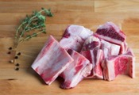
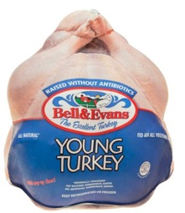
Quality You Can Trust
Connecticut | Westchester County | Putnam County | Dutchess County
Since 1881
Class Name: Veal (Continued)
Item #
05840
05850
05875
05880
05885
05900
Description
BRD 4oz Veal Patty
BRD 6oz Veal Patty
Veal Hearts
Veal Kidneys
Veal Bones
Veal Outside Skirts
Pack Size
1-10 LB
1-10 LB
1-10 LB
1-10 LB
1-50LB
10 LB
Unit Size
Case
Case
Case
Case
Case
Case
Veal Bones
Veal Bones
Class Name: Bell & Evans Turkey
Item #
09400
09405
09410
09415
09420
09425
09430
09435
09440
09445
09446
09444
09444P
09400OR
09405OR
09410OR
09415OR
09420OR
09425OR
09430OR
09435OR
09440OR
09445OR
09446OR
09450
09447
094471
Description
Turkey 08/10
Turkey 10/12
Turkey 12/14
Turkey 14/16
Turkey 16/18
Turkey 18/20
Turkey 20/22
Turkey 22/24
Turkey 24/26
Turkey 26/28
Turkey 28/30
Turkey 30/32
Turkey 32/34
Organic Turkey 8/10
Organic Turkey 10/12
Organic Turkey 12/14
Organic Turkey 14/16
Organic Turkey 16/18
Organic Turkey 18/20
Organic Turkey 20/22
Organic Turkey 22/24
Organic Turkey 24/26
Organic Turkey 26/28
Organic Turkey 28/30
Turkey Breast 4/7
Turkey Breast 8/10
Turkey Breast 10/14
Pack Size
4-8/10 LB
4-10/12 LB
4-12/14 LB
2-14/16 LB
2-16/18 LB
2-18/20 LB
2-20/22 LB
2-22/24 LB
2-24/26 LB
2-26/28 LB
1-28/30 LB
1 PC
1 PC
4-8/10 LB
4-10/12 LB
4-12/14 LB
2-14/16 LB
2-16/18 LB
2-18/20 LB
2-20/22 LB
2-22/24 LB
2-24/26 LB
1-26/28 LB
1-28/30 LB
6-4/7 LB
4-8/10 LB
4-10/14 LB
Unit Size
Case
Case
Case
Case
Case
Case
Case
Case
Case
Case
Case
Case
Case
Case
Case
Case
Case
Case
Case
Case
Case
Case
Case
Case
Case
Case
Case
9 MAPLE AVENUE | DANBURY, CT 06810
PHONE: 203-748-2651 | FAX: 203-790-5051
www.OmahaBeefCompany.com

Slide 14

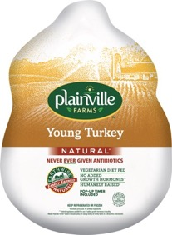
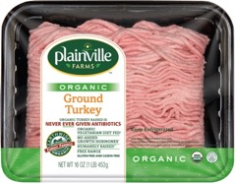
Quality You Can Trust
Connecticut | Westchester County | Putnam County | Dutchess County
Since 1881
Class Name: Turkey Plainville
Item #
09451
09452
09453
09454
09455
09456
09457
09458
09459
09461
09643
09467
09451P
09452P
09453P
09454P
09455P
09456P
09457P
09458P
09459P
09461P
09463P
09467P
094621
094622
0946228
0942623
09462TP
09460
09464
09465
094651
0946511
09466
094682
094683
09469
09470
09471
09472
09474
09474TP
Description
08/10 Turkey
10/12 Turkey
12/14 Turkey
14/16 Turkey
16/18 Turkey
18/20 Turkey
20/22 Turkey
22/24 Turkey
24/26 Turkey
26/28 Turkey
28/30 Turkey
30/Up Turkey
08/10 Turkey Single Pac
10/12 Turkey Single Pac
12/14 Turkey Single Pac
14/16 Turkey Single Pac
16/18 Turkey Single Pac
18/20 Turkey Single Pac
20/22 Turkey Single Pac
22/24 Turkey Single Pac
24/26 Turkey Single Pac
26/28 Turkey Single Pac
28/30 Turkey Single Pac
30/Up Turkey Single Pac
Roasted 10/12 Frozen
Roasted 14/16 Frozen
Plainville 8/Up Bone-In Breast
Roasted 12/14 Frozen
TP Split Breast
Turkey Breast 12 Piece Fresh
Turkey Half
Turkey Gravy 13oz
Gravy Bulk
Bulk Turkey Hearts
8/10 Raw Boneless Breast
Organic Ground Turkey
Turkey Meatballs
Bulk Ground Breast Meat
No Salted Roasted Breast Clean
Oven Browned Breast Clean
Ground Turkey 94%
Bone-In Thighs Bulk Pack
TP Turkey Drumsticks
Pack Size
4-9/10 LB
4-10/12 LB
4-12/14 LB
4-14/16 LB
2-16/18 LB
2-18/20 LB
2-20/22 LB
2-22/24 LB
2-24/26 LB
2-26/28 LB
2-28/30 LB
2-30/ Up
1-9 LB
1-11 LB
1-13 LB
1-15 LB
1-17 LB
1-19 LB
1-21 LB
1-23 LB
1-25 LB
1-27 LB
1-29 LB
1-31 LB
1 Per Case
1 Per Case
4/ Per
1 Per Case
6-2 LB
12-3 LB
1-12 LB
12-13 OZ
4/5 LB
2/10 LB
2-8/10 LB
12 -1 LB
12-12 OZ
2-10 LB
2-7/8 LB
2-7/8 LB
1-12 LB
1-30 LB
6-2 LB
Unit Size
Case
Case
Case
Case
Case
Case
Case
Case
Case
Case
Case
Case
Case
Case
Case
Case
Case
Case
Case
Case
Case
Case
Case
Case
Case
Case
Case
Case
Case
Case
Case
Case
Case
Case
Case
Case
Case
Case
Case
Case
Case
Case
Case

Slide 15
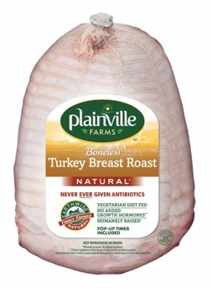
Quality You Can Trust
Connecticut | Westchester County | Putnam County | Dutchess County
Since 1881
Class Name: Turkey Plainville (Continued)
Item #
09475
09475F
09476
09478
09480
09485
0948505
09486
09486FRZ
09490
09491
09495
0949505
09496
09499
0949911
094992
094994
094995
094996
094997
09840
098997
099002
099008
099009
51661
51662
51671
51672
51701
Description
Seasoned Turkey Roast
Roasted 16/Up Frozen
Black Pepper Turkey Breast
Roasted Breast 3/5
Boneless Turkey Breast 2/3 LB
Wht Grn Turkey 1 LB
Bulk Turkey Necks
Bulk Turkey Wings
Grd White Trk 99%
Turkey Tenderloins TP
Turkey London Broil TP
Boneless Skinless Turkey Thigh
Bone-In Turkey Thigh TP
Smoked Turkey
Smoked Turkey Breast
Turkey Steak
Thin Sliced Turkey Cutlet
Honey Turkey Breast
Turkey Bacon
Herb Roasted Breast ABF
Turkey Patties TP
Turkey Drums Bulk
Organic 10/16 Turkey
Organic 16/20 Turkey
Organic 4/7 Turkey Breast
Organic 8/12 Turkey Breast
Organic Pre-Pack Roasted Turkey
Organic Pre-Pack Honey Turkey
Pre-Pack Uncured Virginia Ham
Pre-Pack Honey Maple Ham
Organic Pre-Pack Smoked Turkey
Pack Size
1-25 LB
1 HD
2-7/8 LB
3-4 LB
8-Case
12-1 LB
1-30 LB
30 LB Case
12-1 LB
2/Pack
---
1-30 LB
1-30 LB
1-12 LB
2-4 ½ LB
---
6-1LB
2-7/8 LB
12-8OZ Pkg
2 / Per
---
1-30 LB
4-10/12
2-18/20
6-4/7
4-8/12
8/7 OZ
8/7 OZ
8/7 OZ
8/7 OZ
8/7 OZ
Unit Size
Case
Case
Case
Case
Case
Case
Case
Case
Case
Case
Case
Case
Case
Case
Case
Case
Case
Case
Case
Case
Case
Case
Case
Case
Case
Case
Case
Case
Case
Case
Case
9 MAPLE AVENUE | DANBURY, CT 06810
PHONE: 203-748-2651 | FAX: 203-790-5051
www.OmahaBeefCompany.com

Slide 16

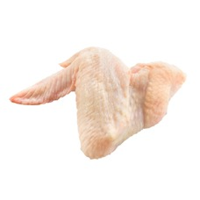
Quality You Can Trust
Connecticut | Westchester County | Putnam County | Dutchess County
Since 1881
Class Name: Turkey MISC
Item #
09940
09800
21200
09310
0315
09320
09325
09335
09340
09345
09355
09365
09366
09369
09507
09752
09840P
09904
09905
09906
099061
21300
Description
765 Raw Turkey Breast
Bulk Ground Turkey
16/18 Turkey Breast Boned
4/7 Fresh Turkey Breast
4/8 Frozen Turkey Breast
8/10 Fresh Turkey Breast
8/10 Frozen Turkey Breast
10/12 Frozen Turkey Breast
12/14 Fresh Turkey Breast
12/14 Frozen Turkey Breast
14/16 Turkey Breast Frozen
16/18 Turkey Breast Frozen
18/20 Turkey Breast Frozen
20/Up Turkey Breast Frozen
Turkey Burgers
Frozen Boneless Turkey Breast
Frozen Turkey Drums Bulk
Smoked Turkey Necks
Smoked Turkey Wings
Smoked Turkey Drums
Smoked Turkey Drums (24-30 OZ)
Turkey Breast Bone-In SPLIT & CYRO
Pack Size
2-7/9 LB
2-10 LB
10/14 LB
6-4/7 LB
6-4/8 LB
4-8/10 LB
4/8-10 LB
4-10/12 LB
4-12/14 LB
4-12/14 LB
2-14/16 LB
2-16/18 LB
2-18/20 LB
2-20/24 LB
1-10 LB
1-40 LB
---
1-30 LB
1-30 LB
1-30 LB
25 PCS
4 Halves
Unit Size
Case
Case
Case
Case
Case
Case
Case
Case
Case
Case
Case
Case
Case
Case
Case
Case
Case
Case
Case
Case
Case
Case
Class Name: Turkey RH Frozen
Item #
09025
09035
09045
09055
09065
09075
09085
09095
09105
09115
09125
09621
09621P
09967
Description
10/12 Frozen Turkeys
12/14 Frozen Turkeys
14/16 Frozen Turkeys
16/18 Frozen Turkeys
18/20 Frozen Turkeys
20/22 Frozen Turkeys
22/24 Frozen Turkeys
24/26 Frozen Turkeys
26/28 Frozen Tureys
RH 28/30 Frozen Turkeys
RH 30/32 Frozen Turkeys
Frozen Boneless Turkey Thigh
Frozen Turkey Wing
Frozen Turkey Necks
Pack Size
4-10/12 LB
4-12/14 LB
4-14/16 LB
2-16/18 LB
2-18/20 LB
2-20/22 LB
2-22/24 LB
2-24/26 LB
2-26/28 LB
2-28/30 LB
2-30/32 LB
30 LB
30 LB
40 LB
Unit Size
Case
Case
Case
Case
Case
Case
Case
Case
Case
Case
Case
Case
Case
Case
Turkey Wing

Slide 17
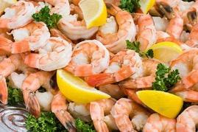

Quality You Can Trust
Connecticut | Westchester County | Putnam County | Dutchess County
Since 1881
Class Name: Seafood Products
Item #
10053
10340
10520
10529
10540P
10590
10622
10623
10800
10900
10905
10910
11700
10310
10410
10420
10610
10620
Description
Salmon Burgers 5oz
Sea Leg Supreme
16/20 White S.O. Shrimp
16/20 Black Tiger Shrimp
16/20 Cook Shrimp Tails On
P&D16/20 Shrimp
8/12 Easy Peel Raw Shrimp (Lucia)
13/15 Easy Peel Shrimp (Lucia)
Jumbo King Crab Legs 9/12
White Tuna Chunk
Tongol Tuna
Lite Tuna 66oz Cans
Chopped Clams
Breaded Sea Scallops
4oz Breaded Clams
6oz Breaded Clams
Shrimp In A Basket
Breaded Fantail Shrimp 16/20
Pack Size
10 LB
6-5 LB
10-5 LB
6-4 LB
5-2 LB
5-2 LB
10-2 LB
10-2 LB
1-20 LB
6-66 OZ
6-66 OZ
6-66 OZ
5 LB
4-3 LB
24-4 OZ/BX
18-6 OZ/BX
12-8 OZ
4-3 LB / CS
Unit Size
Case
Case
Case
Case
Case
Case
Case
Case
Case
Case
Case
Case
Case
Case
Case
Case
Case
Case
Class Name: Butter & Cheese
Item #
12021
12030
12050
12110
12130
12328
12340
12510
12520
12530
12540
1254016W
1254016Y
12599
12600
12620
12635
12680
12735
12740
Description
Cabot Roll Butter
Unsalted Butter
Whipped Tub Butter
Chip Butter 90 CT
Butter Cups 90/CT
Admiration Oleo Solids
Butter Blend
LOL White Cheese
LOL Yellow Cheese
LOL SL White Cheese 120 Ct.
LOL SL Yellow Cheese 120 Ct.
LOL SL White Cheese 160 Ct.
LOL SL Yellow Cheese 160 Ct.
Feta Cheese
Swiss Cheese
Provolone Cheese
McCadam Munster Cheese
Crumble Blue Cheese
Cream Cheese 3 LB
Monterey Jack Cheese
Pack Size
36-1 LB
36-1 LB
2-7 LB
6-5 LB
1-8 LB
30-1 LB
36-1 LB
6-5LB
6-5 LB
6-5 LB
6-5 LB
6-5 LB
6-5 LB
2-9 LB
4-6LB
3-11 LB
6-6 LB
4-5 LB
10-3 LB
1-10 LB
Unit Size
Case
Case
Case
Case
Case
Case
Case
Case
Case
Case
Case
Case
Case
Case
Case
Case
Case
Case
Case
Case

Slide 18

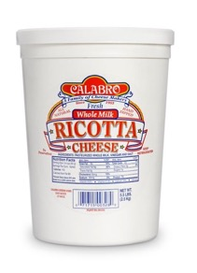

Quality You Can Trust
Connecticut | Westchester County | Putnam County | Dutchess County
Since 1881
Class Name: Butter & Cheese (Continued)
Item #
12750
12755
12763
12788
12850
12865
12905
12920
12950
Description
Yellow Cheddar Block
White Mild Cheddar Block
Heavy Cream
Shredded Jack & Cheddar Fine
LOL Cheese Sauce
Sour Cream
Grated Parmesan
Grated IMP Romano Cheese
15 oz Whip Cream
Pack Size
1-10 LB
1-10 LB
12-1 QT
6-5 LB
6-# 10 Can
6-5 LB
4-5 LB
4-5 LB
12-15 OZ
Unit Size
Case
Case
Case
Case
Case
Case
Case
Case
Case
Class Name: Calabro
Item #
12640
12650
12870
12880
12889
Description
Cal Mozzarella Cheese
Cal Shredded Mozzarella Cheese
Cal Ricotta Cheese
Cal 1.5 oz Boccocini
Cal 3.5 Ovoline
Pack Size
8-5 LB
4-5 LB
6-3 LB
2-3 LB
2-3 LB
Unit Size
Case
Case
Case
Case
Case
Class Name: Deli Cold Cuts
Item #
22625
23625
23621
23627
23629
23910
24115
24117
24120
24130
24132
24141
Description
104 Turkey Breast Oil Browned
Hummel Foot Long Franks S/ON
Hummel 6-1 Dinner Franks
Hummel Red Hots
Hummel XL N/C Franks
Hillshire Ring Kielbasa
Keg Corn Beef Briskets
Keg Corn Beef Briskets Flats
Corn Beef Briskets CH Omaha Beef
Flat Cut Corn Beef Briskets Whole
Flat Cut Corn Beef Briskets Retail
Corn Beef Flats (Farm)
Pack Size
2-8 LB
5 LB
4-5 LB
12-1 LB
4-5 LB
24 / .14 OZ
80 LB
80 LB
2-12 LB
2-8 LB
8- 3 to 4 LB
4-6 LB
Unit Size
Case
Case
Case
Case
Case
Case
Case
Case
Case
Case
Case
Case
9 MAPLE AVENUE | DANBURY, CT 06810
PHONE: 203-748-2651 | FAX: 203-790-5051
www.OmahaBeefCompany.com

Slide 19


Quality You Can Trust
Connecticut | Westchester County | Putnam County | Dutchess County
Since 1881
Class Name: Hormel Products
Item #
22165
22170
22180
22190
22700
22720
22740
22750
22760
22780
22790
80850
Description
Honey Ham
Old Tyme Ham
W/A Boiled Ham
Virginia Baked Ham
Di Lusso Genoa
Homeland Salami
Boneless Procuitto
Wide SL Pepperoni
Long Pepperoni
Bulk Sliced Pepperoni
SL Dried Beef
Bacon Bits
Pack Size
2-13 LB
3-12 LB
2-13 LB
2-14 LB
4-7 LB
6-6 LB
1-6 LB
6-3 LB
12-3 LB
1-10 LB
1-3 LB
4-5 LB Bag
Unit Size
Case
Case
Case
Case
Case
Case
Case
Case
Case
Case
Case
Each
Class Name: Old Neighborhood
Item #
21005
21010
21060
22570
22580
23500
23570
23600
23620
23630
23700
23710
23720
23725
23780
Description
Narrow Bologna
Cooked Salami
Cooked Roast Beef Thin & Trim
Cooked Corned Rounds
Cooked Pastrami Rounds
Skinless AM Franks 8’s
Skinless PB Franks 8’s
Natural Casing Franks
12” Footlong Franks
¼ LB 7” Franks
Knockwurst
Bratwurst
Locanico
Chourico
Gyro Strips
Pack Size
3-3 LB
1-6 LB
1-12/16 LB
2-6 LB
2-6 LB
12-14 OZ
12-1 LB
1-10 LB
1-10 LB
1-10 LB
1-10 LB
2-5 LB
12/12 OZ
2-5 LB
1-10 LB
Unit Size
Case
Case
Case
Case
Case
Case
Case
Case
Case
Case
Case
Case
Case
Case
Case
Class Name: Sally Sherman
Item #
20015
20215
20019
20065
20119
20219
26025
Description
30 LB Potato Salad
30 LB Macaroni Sald
8 LB Potato Salad
8 LB Potato & Egg Salad
8 LB Cole Slaw
8 LB Macaroni Salad
8 LB Red Royal Potato Salad
Pack Size
1-30 LB
1-30 LB
1-8 LB
1-8 LB
1-8 LB
1-8 LB
1- 8 LB
Unit Size
Case
Case
Case
Case
Case
Case
Case

Slide 20


Quality You Can Trust
Connecticut | Westchester County | Putnam County | Dutchess County
Since 1881
Class Name: Potato Products
Item #
15015
15020
15030
15040
15052
15053
15090
15130
15150
15160
15200
15220
15235
15400
15470
15131
Description
Thin French Fries Blues
Crinkle French Fries
Straight French Fries
Shoestring French Fries
Steak French Fries
Coated Straight Fries
Potato Cups
Hash Brown Real Patties
Cajun Curly Fries
Sweet Potato French Fries
Onion Rings Homestyle
Breaded Zucchini Sticks
Breaded Mozzarella Sticks
Jalapeno & Cheddar Poppers
Beer Batter Onion Rings
Tater Tots
Pack Size
6-5 LB
6-5 LB
6-5 LB
6-4.5 LB
6-5 LB
6-4.5 LB
1-175 CT
12-120 CT
6-5 LB
6-2 ¼ LB
8- 2 LB
6-2 ½ LB
4-3 LB
4-4 LB
4-2.5 LB
6-5 LB
Unit Size
Case
Case
Case
Case
Case
Case
Case
Case
Case
Case
Case
Case
Case
Case
Case
Case
Class Name: Bakery Products
Item #
16110
16115
16130
16131
16132
16133
16134
16300
16500
16530
16540
16120
Description
Thomas English Muffins
Thomas Sandwich English
Plain Tortilla Wraps 12”
Wheat & Honey Wraps
Tomato Wraps
Herb Garlic Wraps
Spinach Wraps
Puff Pastry Dough Sheets
Pie Shells 10”
On Top Topping
Pretzel Super King
Pita Bread
Pack Size
6-12 PKG
48-3.25 OZ
6-1 DOZ
6-1 DOZ
6-1 DOZ
6-1 DOZ
6-1 DOZ
1-100 PCS
24-10”
12-16 OZ
50-5.5 OZ
6-10 CT
Unit Size
Case
Case
Case
Case
Case
Case
Case
Case
Case
Case
Case
Case
9 MAPLE AVENUE | DANBURY, CT 06810
PHONE: 203-748-2651 | FAX: 203-790-5051
www.OmahaBeefCompany.com

Slide 21


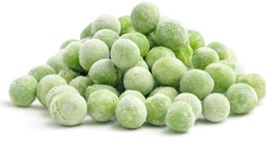
Quality You Can Trust
Connecticut | Westchester County | Putnam County | Dutchess County
Since 1881
Class Name: Sweet Street
Item #
16610
16630
16720
16730
16735
16750
16790
16795
16820
16825
16830
16860
Description
Carrot Cake
Black Forest Torte
Sour Cream Coffee Cake
Torta Tiramisu
Peanut Butter with Reeses
Irish Cream Bash
Pecan Pie
Key Lime Pie
Choc Lovin Spoon
Oreo Cookie Pie
Caramel Apple Granny
The Big Blitz w/ Snickers
Pack Size
4-CS
4-CS
4-CS
2-CS
4-CS
4-CS
4-CS
4-CS
4-CS
4-CS
4-CS
4-CS
Unit Size
Case
Case
Case
Case
Case
Case
Case
Case
Case
Case
Case
Case
Class Name: Carousel Cakes
Item #
16210
16230P
17150
17180
17320
Description
Plain Cheese Cake 16 SL
Strawberry Cheesecake
Black & White Mousse Supreme
Chocolate Mousse Supreme
Cannoli Pies – 10 Inch
Pack Size
2-5 LB
1-5 LB
2-CS
2-CS
4-CS
Unit Size
Case
Piece
Case
Case
Case
Class Name: Frozen Vegetables
Item #
15240
15250
15255
15260
15265
15280
15290
15300
15310
15315
15320
15330
15555
16030
Description
Cut Corn
Peas Petite
Peas & Carrots
Whole Green Beans
Cut Green Beans
Mixed Italian Vegetable
Leaf Spinach
Chopped Spinach
Broccoli Spears
Broccoli Florets
Carrots Whole Baby
Chopped Broccoli
Garden Burgers
Sliced Strawberries
Pack Size
12-2.5 LB
12-2.5 LB
12-2.5 LB
12-2 LB
12-2 LB
12-2 LB
12-3 LB
12-3 LB
12-2 LB
12-2 LB
12-2 LB
12-2.5 LB
48-3.4 OZ
6-#10 CAN
Unit Size
Case
Case
Case
Case
Case
Case
Case
Case
Case
Case
Case
Case
Case
Case
9 MAPLE AVENUE | DANBURY, CT 06810
PHONE: 203-748-2651 | FAX: 203-790-5051
www.OmahaBeefCompany.com

Slide 22
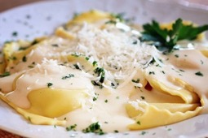

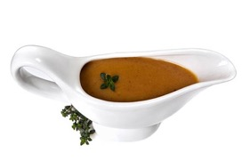
Quality You Can Trust
Connecticut | Westchester County | Putnam County | Dutchess County
Since 1881
Class Name: Rotanelli
Item #
25010
25020
25030
25040
25090
25100
25150
25300
25340
25410
25440
25450
25460
Description
Cheese Ravioli 300 CT
Meat Ravioli 300 CT
Jumbo Cheese Ravioli
Jumbo Meat Ravioli Preckd
Stuffed Shells
Manicotti
Cheese Tortellini
Cheese Lasagna
Pasta Sheets
Battered Eggplant
½ OZ Meatballs
1 OZ Meatballs
2 OZ Meatballs
Pack Size
1-300 CT
1-300 CT
1-100 CT
1-100 CT
3-26 CT 3OZ
6-12 CT
1-10 LB
4-5 LB TRAY
1-10 LB
1-10 LB
1-10 LB
1-10 LB
1-10 LB
Unit Size
Case
Case
Case
Case
Case
Case
Case
Case
Case
Case
Case
Case
Case
Class Name: Salad Dressing
Item #
80000
80110
80210
80230
80250
80260
80270
80280
80310
80320
80325
80330
80350
80360
90060
90070
Description
Hellmann’s Gal Mayonnaise
Admiration Heavy Duty Mayo
Blue Cheese Dressing
Russian Dressing
Creamy Italian Dressing
Golden Italian Dressing
Low Calorie Italian
Ranch Dressing
Honey Dijon Mustard
Great Caesar Dressing
Creamy Caesar Dressing
Zinfandel Vinaigrette
Peppercorn
Balsamic Vinaigrette
Cocktail Sauce
Tar Tar Sauce
Pack Size
4-1 GAL
4-1 GAL
4-1 GAL
2-1 GAL
4-1 GAL
2-1 GAL
2-1 GAL
4-1 GAL
4-1 GAL
4-1 GAL
4-1 GAL
4-1 GAL
2-1 GAL
2-1 GAL
4-1 GAL
4-1 GAL
Unit Size
Case
Case
Case
Case
Case
Case
Case
Case
Case
Case
Case
Case
Case
Case
Case
Case
Class Name: Gravy
Item #
83500
83505
83510
83530
83555
83600
83605
83620
83660
Description
Beef Base
Chicken Base
Chicken Base Pail
Clam Base
Country Gravy Mix
Brown Gravy
Beef Gravy
Turkey Gravy
French Demi-Glaze
Pack Size
12-16 OZ
12-16 OZ
1-30 LB TUB
12-16 OZ
8-22 OZ
12-#5 CAN
12-#5 CAN
12-#5 CAN
4-16 OZ
Unit Size
Case
Case
Case
Case
Case
Case
Case
Case
Case

Slide 23
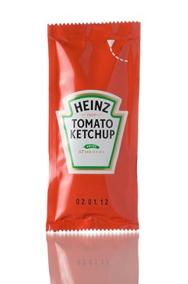
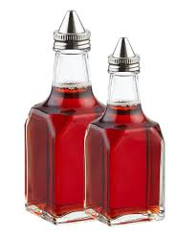
Quality You Can Trust
Connecticut | Westchester County | Putnam County | Dutchess County
Since 1881
Class Name: Soup Can
Item #
83210
83230
83800
Description
New England Clam Chowder
Minestrone Soup
Corn Beef Hash
Pack Size
12-#5 CAN
12-#5 CAN
12-#5 CAN
Unit Size
Case
Case
Case
Class Name: PC Condiments
Item #
95010
95030
95040
95055
95060
95061
95070
95210
95220
95250
Description
Sugar
Salt
Pepper
Heinz Ketchup
Mustard
Gulden’s Mustard
Hellmans Mayo
Grape Jelly
Assorted Jelly
Pancake Syrup
Pack Size
2000 CT
3-1000 CT
3-1000 CT
3-1000 CT
1-500CT
500CT
1-200CT
1-200CT
1-200CT
120-1.4O
Unit Size
Case
Case
Case
Case
Case
Case
Case
Case
Case
Case
Class Name: SB Bean & Olive
Item #
31710
31715
31730
31735
31740
31745
32025
32085
Description
Chickpeas 24-16 OZ
Chickpeas #10
White Kidney Beans 15.5 OZ
Red Kidney Beans 15.5 OZ
Red Kidney Beans 6/#10
White Kidney Beans
Small Black Olive
Spanish Stuff Queen Olive
Pack Size
24-16 OZ
6-#10 CAN
24-15.5 OZ
24-15.5 OZ
6-#10 CAN
6-#10 CAN
12-12 OZ
4-1 GAL
Unit Size
Case
Case
Case
Case
Case
Case
Case
Case
Class Name: SB Oil & Vinegar
Item #
30010
30019
10070
30150
30160
30180
30190
Description
Red Can Olive Oil
Virginola Oil
Ex Virgin Olive Oil
Red Vinegar
White Vinegar
Balsamic Vinegar 17 oz
Balsamic Vinegar 5 Liter
Pack Size
6-3 LITER
6-1 GAL
4-76 OZ
4-1 GAL
4-1 GAL
12-17 OZ
2-5 LITER
Unit Size
Case
Case
Case
Case
Case
Case
Case

Slide 24


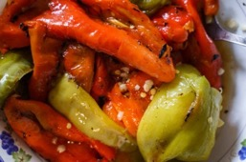
Quality You Can Trust
Connecticut | Westchester County | Putnam County | Dutchess County
Since 1881
Class Name: Tomatoes
Item #
30220
30223
30224
30225
30230
30350
30360
30410
30420
30455
30460
30480
30490
30610
30615
30618
30619
30620
30623
30625
30630
30640
30645
30648
32640
Description
Italian Tomato
35 oz Italian Tomato
Italian Cherry Tomatoes
28 oz Hand Picked Tomatoes
Italian San Marzano
Calf Crushed Tomato
28 oz Crushed Tomato
Tomato Puree
28oz Tomato Puree
Pizza Sauce Glass
Pizza Sauce
Tomato Paste
6 oz Tomato Paste
Marinara Sauce Gal
Marinara Sauce Qt
Marinara Sauce 16 oz
Fra Diavolo Sauce 16 oz
Filet Di Pomodoro Sauce Qt
Filet Di Pomodoro Sauce 16 oz
Tomato Basil Sauce Qt
Vodka Sauce Qt
Spaghetti Sauce Gal
Spaghetti Sauce Qt
Spaghetti Sauce 16oz
Sundried Tomato 10 oz
Pack Size
6-#10 CAN
12-35 OZ
24-14 OZ
12-28 OZ
12-28 OZ
6-#10 CAN
12-28 OZ
6-#10 CAN
12-28 OZ
12-16 OZ
6-#10 CAN
6-#10 CAN
48-6 OZ
4-1 GAL
12-32 OZ
12-16 OZ
12-16 OZ
12-32 OZ
12-16 OZ
12-32 OZ
12-32 OZ
4-1 GAL
12-32 OZ
12-16 OZ
12-10 OZ
Unit Size
Case
Case
Case
Case
Case
Case
Case
Case
Case
Case
Case
Case
Case
Case
Case
Case
Case
Case
Case
Case
Case
Case
Case
Case
Case
Class Name: Sclafani Misc.
Item #
32605
32610
35070
32650
32860
32870
32920
32780
30740
31010
31012
31013
31015
31400
31510
32600
Description
Capers (Non Pairelle) 3.7
Capers in Salt (Non Pairelle) 3
Italian Provolone
Sundried Tomato Bulk
Panchetta
Sopresatta Large
Parma Boneless Proscuitto
Flavored Bread Crumbs
Pepperchini
Hot Cherry Peppers
SL Hot Cherry Peppers
Sweet Roasted Pepper Strips
SL Jalapeno Peppers
Roasted Peppers
Red Pepper Hulls
Capers
Pack Size
12-3.7 OZ
12-3.7 OZ
1-25 LB
1-5 LB
6-2 LB
3-6 LB
1-13 LB
12-16 LB
4-1 GAL
4-1 GAL
4-1 GAL
6-#10
4-1 GAL
6-#10 CAN
4-1 GAL
6-32 OZ
Unit Size
Case
Case
Case
Case
Case
Case
Case
Case
Case
Case
Case
Case
Case
Case
Case
Case

Slide 25

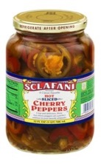
Quality You Can Trust
Connecticut | Westchester County | Putnam County | Dutchess County
Since 1881
Class Name: Sclafani Pasta
Item #
38010
38020
38030
38040
38050
38060
38070
38080
38090
38095
38110
38130
38140
38150
38170
38182
38183
38184
38195
38199
Description
IMP #1 Spaghetti
IMP #2 Spaghettinni
IMP #3 Linguini
IMP #4 Linguini Fini
IMP #5 Cappelini
IMP #48 Fusilli
IMP #49 Rigatoni
IMP #8 Cut Ziti
IMP #9 Penne Rigate
Bulk Penne Rigate
IMP #10 Ditali
IMP #12 Double Elbows
IMP #13 Medium Shells
IMP #14 Baby Shells
IMP #16 Orzo
IMP #60 Bow Tie Pasta
IMP #7 Rigatoni
IMP #61 Tri-Color Fusilli
IMP #200 Long Fusilli
Orechiette (Little Hats)
Pack Size
20-1 LB
20-1 LB
20-1 LB
20-1 LB
20-1 LB
20-1 LB
20-1 LB
20-1 LB
20-1 LB
20-10 LB
20-1 LB
20-1 LB
20-1 LB
20-1 LB
20-1 LB
20-1 LB
20-1 LB
20-1 LB
20-1 LB
20-1 LB
Unit Size
Case
Case
Case
Case
Case
Case
Case
Case
Case
Case
Case
Case
Case
Case
Case
Case
Case
Case
Case
Case
Class Name: Sclafani Peppers
Item #
30710
30850
31019
31310
31320
31330
31380
31390
31405
31515
31590
31595
31599
32035
Description
Giardinera
Mushroom Stems and Pcs
Sweet Antipaso Peppers
Hot Sliced Jalapeno Peppers
Sweet Cherry Peppers
Hot Cherry Peppers
Sweet Stuffed Peppers
Hot Stuffed Peppers
Roasted Peppers
Pepper Hulls
Mixed Pepper Strips
Cosmo Red Pepper Strips
Pepper Strips Sweet Red
Queen Salad Olives
Pack Size
4-1 GAL
6-#10 CAN
12-12 OZ
12 OZ
12-32 OZ
12-32 OZ
4-1 GAL
4-1 GAL
12-7 OZ
12-32 OZ
6-#10 CN
4-1 GAL
4-1 GAL
12-10 OZ
Unit Size
Case
Case
Case
Case
Case
Case
Case
Case
Case
Case
Case
Case
Case
Case
9 MAPLE AVENUE | DANBURY, CT 06810
PHONE: 203-748-2651 | FAX: 203-790-5051
www.OmahaBeefCompany.com

Slide 26
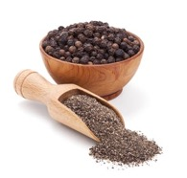
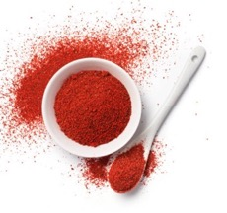
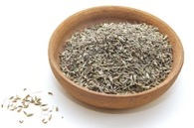
Quality You Can Trust
Connecticut | Westchester County | Putnam County | Dutchess County
Since 1881
Class Name: Spices
Item #
935503
9356025
935653
935703
935723
93600S5
9365163
93642
93643
93646
93647
93648
93649
93651
93652
93653
93654
93655
936601
93700053
937905R
938255
938303
938304
93832
93832
93832C
93891
938935
938936
93894
93895
938967
938968
93897
93898
93900
93550
935500
935501
935502
93556
93560
93561
93562
Description
Black Pepper Table Mesh
Crushed Red Pepper
Cayenne Pepper
Paprika
Ground Cumin
Granulated Garlic
S.H. Cayenne Pepper
Montreal Steak Rub
Granulated Onion
Ground Fennel
Onion Flakes
Black Pepper Butchers Grind
Salt Free Blend
Mesquite Rub
Pickling Spice
Cumin Seeds
Bakers Cinnamon
Celery Salt
Oregano
Fennel Seed
Pocono Steak Rub 6 OZ
Cowboy Steak Rub
Cajun Spice
Rosemary
Sea Salt Fine
Sea Salt Course
Ground White Pepper
Seasoned Salt
Adobo Spice
Chipotle
Sweet Bourbon Seasoning
Sweet & Sassy Jerk
Memphis BBQ Rub
Garlic Pepper
Spicy Buffalo Seasoning
Montreal Chicken Rub
Black Pepper Table Mesh
Small Ground Nutmeg
Table Salt
Kosher Salt
Black Pepper Butchers Grind
Crushed Red Pepper
Thyme Leaves
Adobo
Cayenne Pepper
Pack Size
3.5 OZ
2.5 OZ
3 OZ
3 OZ
4 OZ
4 OZ
3.5 OZ
7 OZ
5.5 OZ
RETAIL
RETAIL
RETAIL
3 OZ
RETAIL
3 OZ
4 OZ
4 OZ
5 OZ
1 OZ
3 OZ
6 OZ
5 OZ
3 OZ
1 OZ
7 OZ
7 OZ
---
8 OZ
6 OZ
4 OZ
5 OZ
5 OZ
4 OZ
3 OZ
4 OZ
5 OZ
16 OZ
16 OZ
32 OZ
32 OZ
16 OZ
12 OZ
7 OZ
24 OZ
16 OZ
Unit Size
Each
Each
Each
Each
Each
Each
Each
Each
Each
Each
Each
Each
Each
Each
Each
Each
Each
Each
Each
Each
Each
Each
Each
Each
Each
Each
Each
Each
Each
Each
Each
Each
Each
Each
Each
Each
Each
Each
Each
Each
Each
Each
Each
Each
Each
Black Pepper
Paprika
Fennel Seed

Slide 27
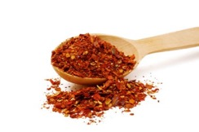
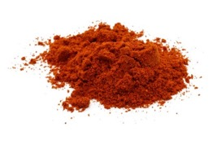
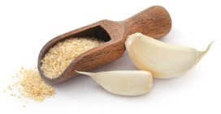
Quality You Can Trust
Connecticut | Westchester County | Putnam County | Dutchess County
Since 1881
Class Name: Spices (Cont.)
Item #
93570
93572
93600S
93605
93614
93615
9362516
93635
93640
93644
93645
93650
93660
9370005
93701
937905
93820
93825
93830
938305
938306
938307
93831
93834
93835
93838
93839
93840
93890
93892
93899
93902
907302
93551
93590
93591
93600
93621
93700
93710
93711
93730
93740
93780
93790
Description
Small Paprika
Small Cumin
Small Granulated Garlic
Small Garlic Powder
Small Italian Garlic Pepper
Small Imported Basil
Small S.H. Cayanne Pepper (Super Hot)
Small Ground Cumin
Small Parsley Flakes
Small Granulated Onion
Small Montreal Steak Rub
Small Chili Powder
Small Oregano
Small Fennel Seed
Small Ground Fennel
Small Pocono Steak Rub
Small Lemon Pepper Mix
Small Cowboy Steak Rub
Small Cajun Spice
Small Cinnamon
Small Ground Ginger
Small Rosemary
Small Taco Seasoning
Small Onion Powder
Small Celery Salt
Small Curry Powder
Small Pickling Spice
Small Tarragon
Small Bay Leaves
Small White Pepper
Small Montreal Chicken Rub
Small Minced Onion
Large Whole Bay Leaves
Large Cumin Seed
Large Parsley Flakes
Large Imported Basil
Large Granulated Garlic
Large Ground Basil
Large Fennel Seed
Large Black Pepper Butchers Grind
Large Coarse Sea Salt
Large Black Pepper Table Mesh
Large Paprika
Large Garlic Powder
Large Crushed Red Pepper
Pack Size
16 OZ
1-20 OZ
22 OZ
16 OZ
20 OZ
3.5 OZ
1-16 OZ
20 OZ
2 OZ
16 OZ
1 LB
20 OZ
8 OZ
16 OZ
13 OZ
26 OZ
26 OZ
16 OZ
6 OZ
16 OZ
16 OZ
6 OZ
16 OZ
16 OZ
16 OZ
16 OZ
12 OZ
3 OZ
8 OZ
1 LB
20 OZ
12 OZ
5 LB
4 LB
16 OZ
16 OZ
4.5 LB
14 OZ
1-3.75 LB
1-3.75 LB
8 LB
3.75 LB
4 LB
1-7 LB
1-3.75 LB
Unit Size
Each
Each
Each
Each
Each
Each
Each
Each
Each
Each
Each
Each
Each
Each
Each
Each
Each
Each
Each
Each
Each
Each
Each
Each
Each
Each
Each
Each
Each
Jug
Jug
Jug
Jug
Jug
Jug
Jug
Jug
Jug
Jug
Jug
Jug
Jug
Jug
Jug
Jug
Cayanne
Chili Powder
Granulated Garlic

Slide 28
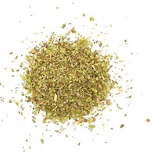
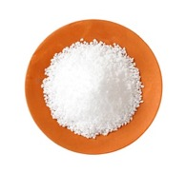
Quality You Can Trust
Connecticut | Westchester County | Putnam County | Dutchess County
Since 1881
Class Name: Spices (Cont.)
Item #
93810
93815
9383005
93837
93894L
939023
93903
93904
93905
93906
93907
93525
93525P
9362516B
9362517B
9362518B
9362519B
9362520B
Description
Large Chili Powder
Large Kosher Salt
Large Cajun Spice
Large Super Hot Cayanne
Large Chipotle Powder
Large Minced Onion
Large Dill Weed
Large Curry Powder
Large Greek Oregano
Large Onion Powder
Large Seasoning Salt
Kosher Salt
Kosher Salt
Bulk S.H. Cayanne Pepper 10 LB
Bulk Adobo Seasoning
Bulk Smokehouse Chicken Rub
Bulk Mesquite Seasoning
Bulk Sweet Bourbon Seasoning
Pack Size
4 LB
8 LB
5 LB
4 LB
4 LB
3 LB
1.75 LB
3.5 LB
16 OZ
4 LB
6 LB
12-3 LB
---
10 LB
10 LB
10 LB
10 LB
10 LB
Unit Size
Jug
Jug
Jug
Jug
Jug
Jug
Jug
Jug
Jug
Jug
Jug
Box
Box
Box
Box
Box
Box
Box
Oregano
Kosher Salt
9 MAPLE AVENUE | DANBURY, CT 06810
PHONE: 203-748-2651 | FAX: 203-790-5051
www.OmahaBeefCompany.com

